Slide 1

US healthcare Analysis 2019-20
By Dakshitha G

Slide 2

Objective
The project aims to conduct a comprehensive analysis of one year's worth of healthcare industry data utilizing Power BI. The analysis will focus on presenting crucial trends and insights to the United States government, aiding in informed decision-making and strategic planning.

Slide 3
Data Overview
Fact Table
Patient Table
Specialty Table
Transaction Table
Physician Table
Payer Table
CPT table
Diagnosis Code Table
Hospital Table
Date Table

Slide 4
Key Deliverables 1. Executive Summary Dashboard: Develop an Executive Summary dashboard highlighting essential Key Performance Indicators (KPIs) pertinent to the healthcare industry. Provide succinct summaries of critical findings and trends. 2. Stakeholder-Specific Views: Create distinct dashboard views tailored to various stakeholders including Hospitals, Payers, Providers, and Patients. Customize insights and metrics relevant to each stakeholder group, ensuring actionable information.

Slide 5
Highlights 1. COVID-19 Impact Analysis: Conduct a thorough examination of the COVID-19 pandemic's impact on the healthcare sector. Informed Decision-Making: Equip government officials with actionable insights to facilitate informed decision-making. 2. Strategic Planning Support: Provide data-driven inputs essential for strategic planning initiatives within the healthcare domain..

Slide 6
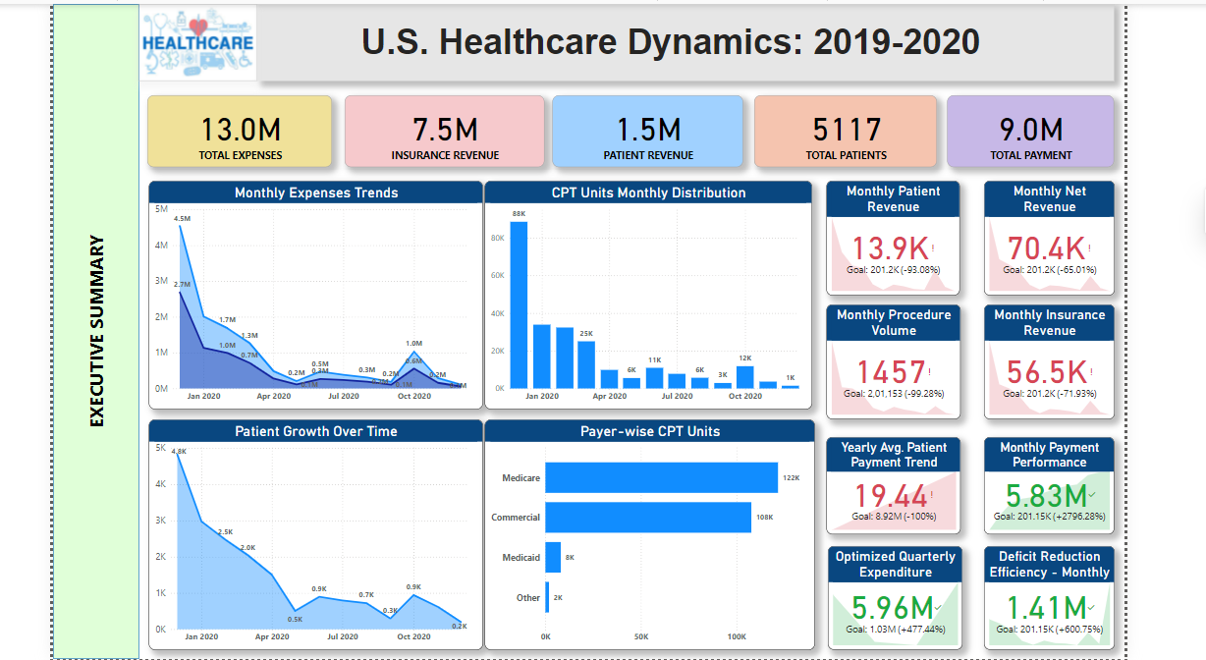
Dashboard

Slide 7
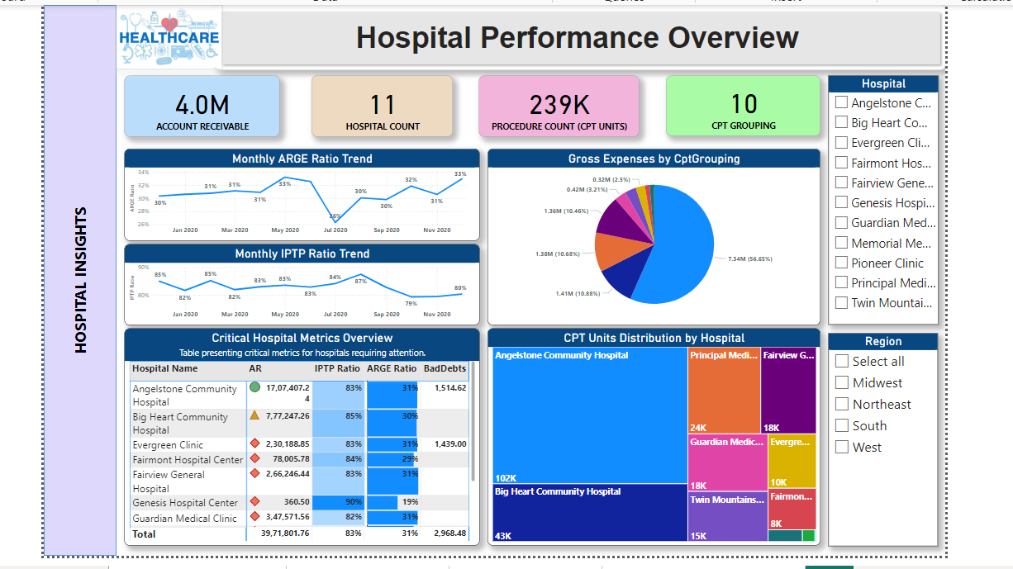
Dashboard

Slide 8
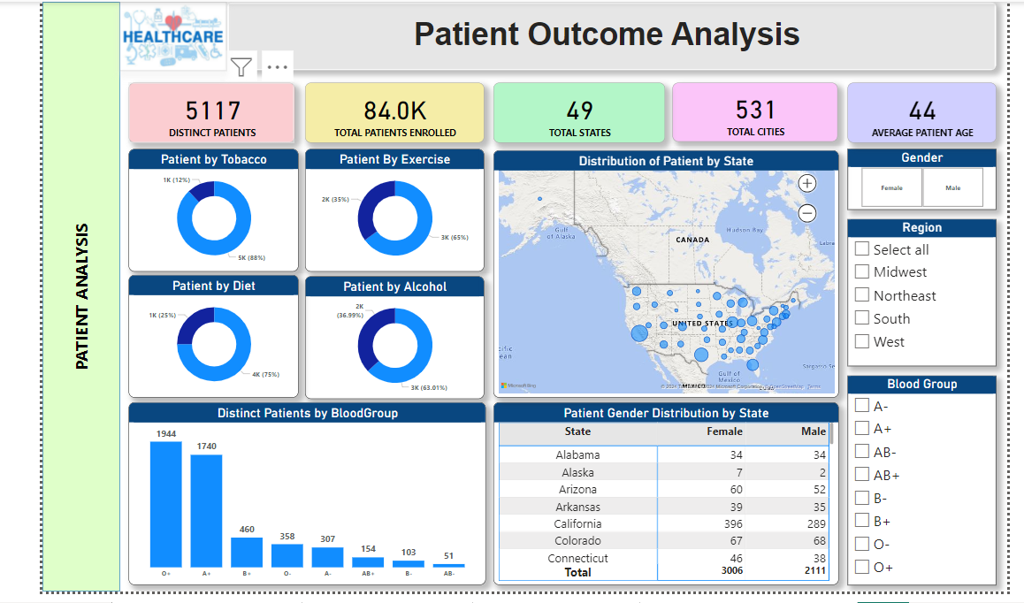
Dashboard

Slide 9
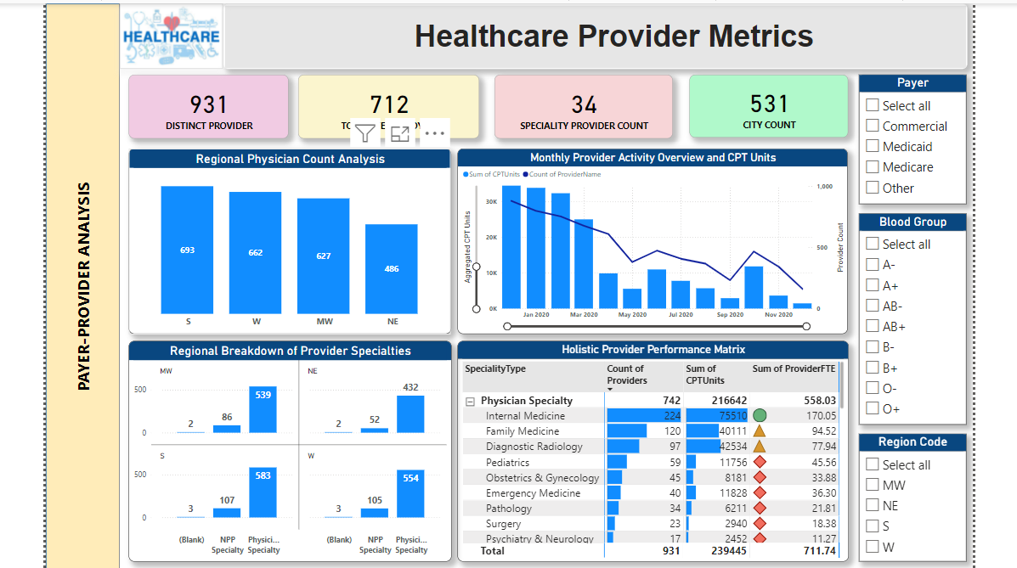
Dashboard

Slide 10

Thank you

